Slide 1
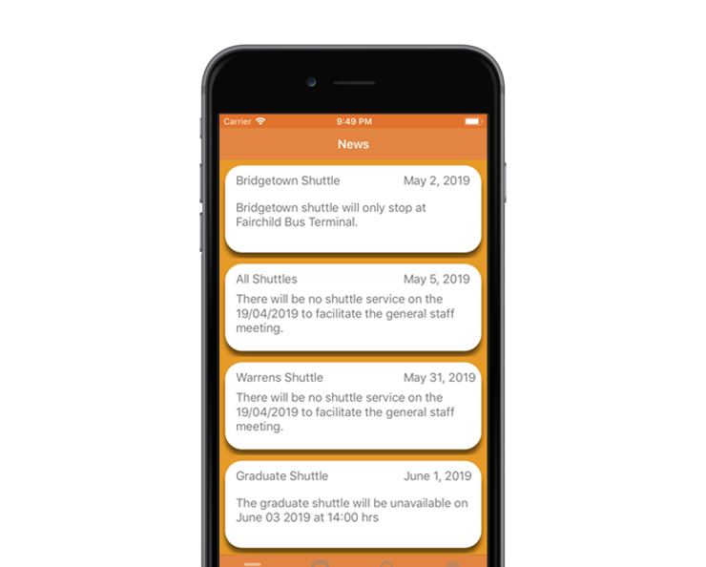
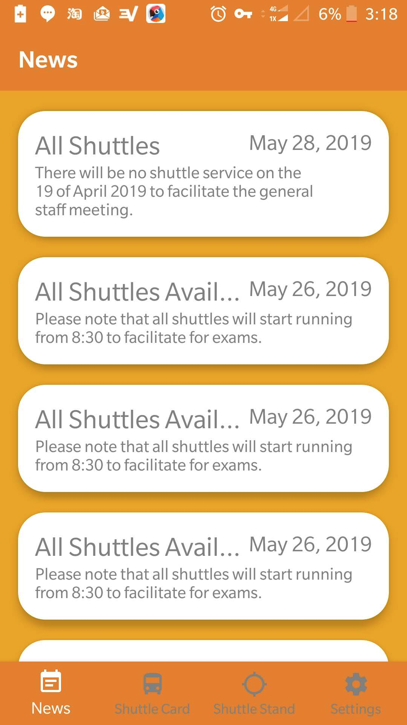
UWI Shuttle
Service iOS
Application
By NIRO Solutions

Slide 2
Outline
The Problem
The Student iOS Application
Android & iOS: A Comparison
What’s Next?
Questions

Slide 3
The Problem

Slide 4
What is the
Problem
The Current UWI Cave Hill Bus Service is Inefficient.
The process of verifying a student before they get onto the shuttle is very tedious, time consuming and inefficient.
The driver has to look at all of the student ID cards and verify them by checking their photo and official registration stamp for the current year.

Slide 5
What students do currently
They complain, wait, wait, wait then wait some more until the bus appears.
Students are forced to seek other means of transportation. So the are basically paying double for one service.
Admin keeps a physical log of data but what really happens to this data besides storage? Nothing

Slide 6
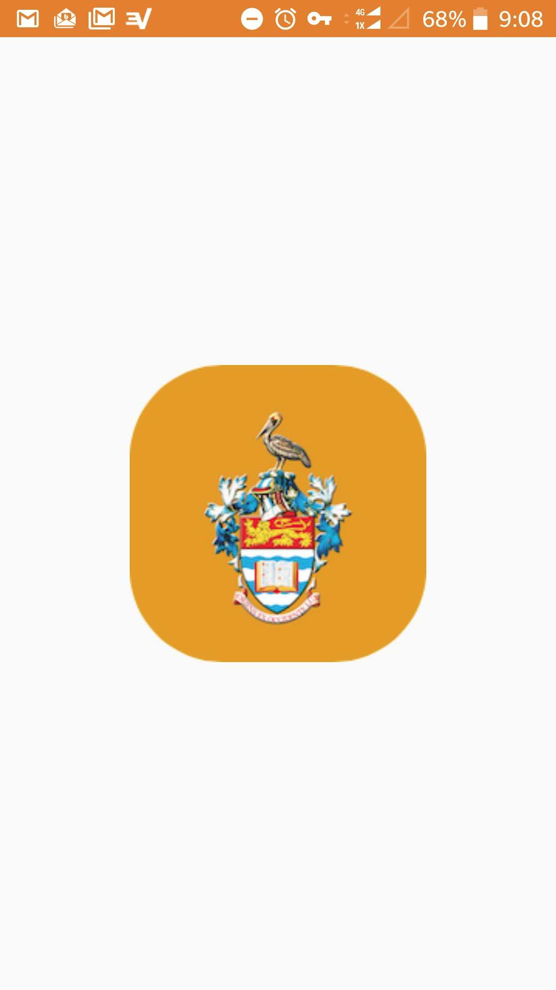
iOS Student Application
News Updates
Shuttle Card
Shuttle Stand
Settings
Push Notification

Slide 7
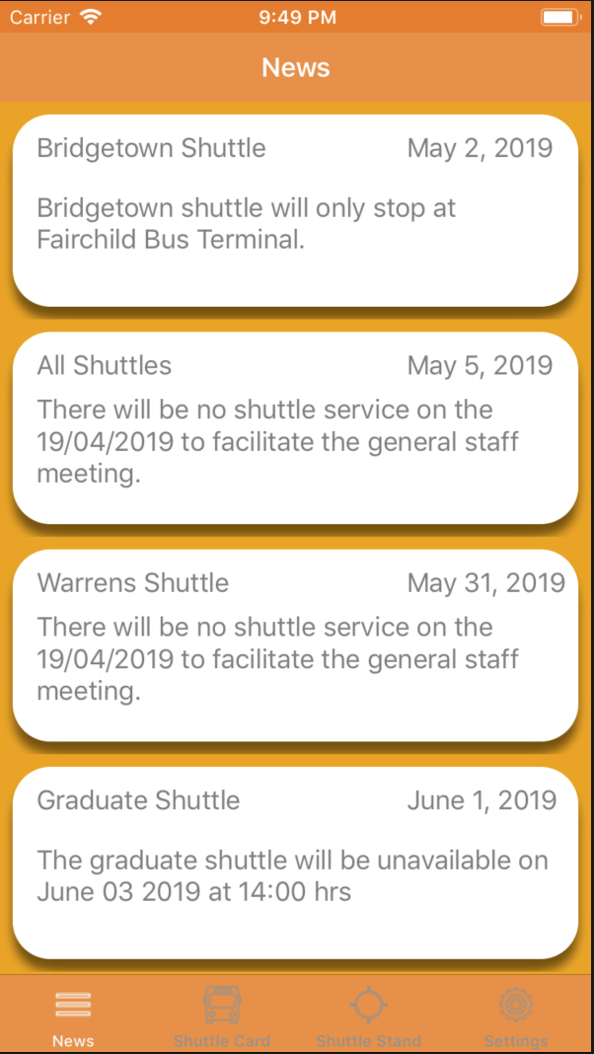
News Updates
01
Ordered Data by Date
Instant Changes
Caching for Speed & No Internet

Slide 8
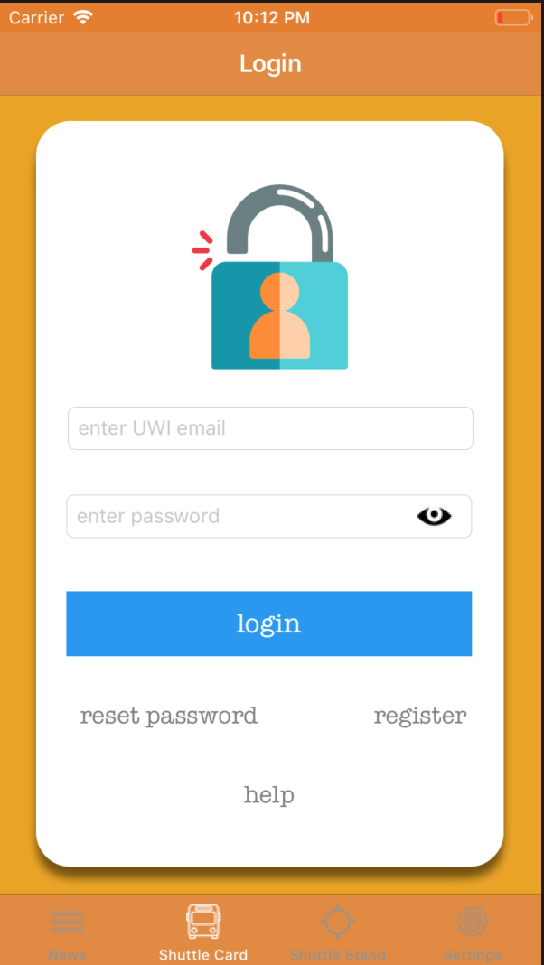
Shuttle Card
02
Authentication by Firebase
User Verification
Email Validation
Help

Slide 9
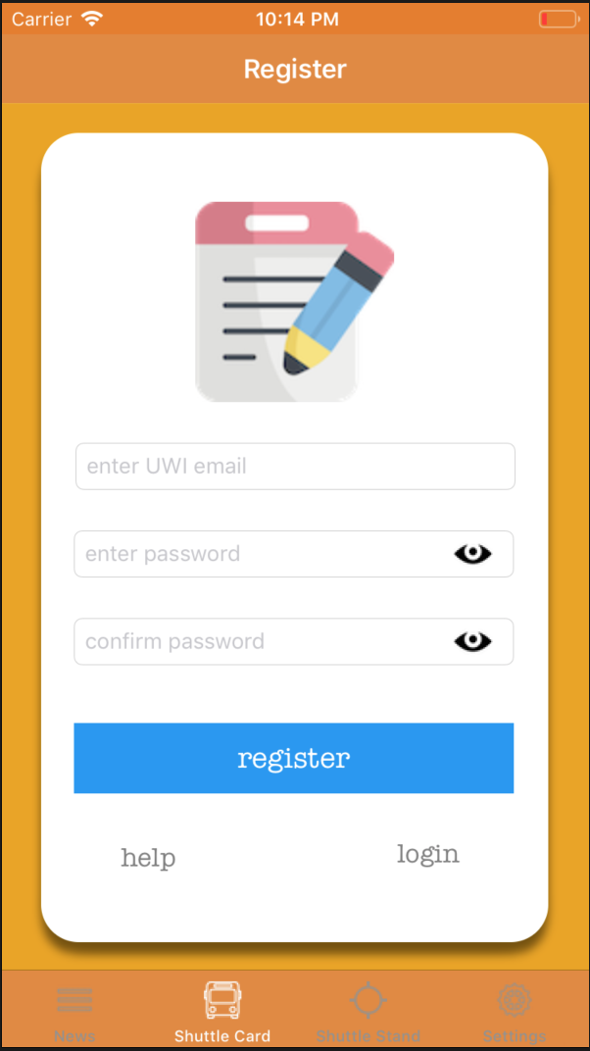
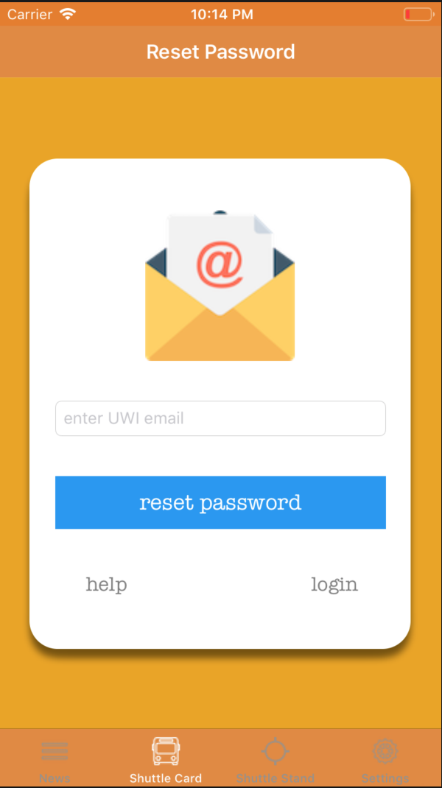
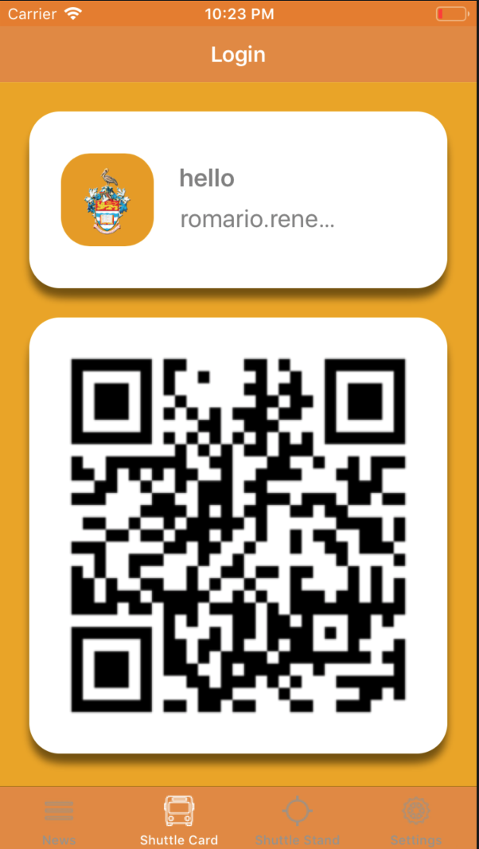
Other Application Features

Slide 10
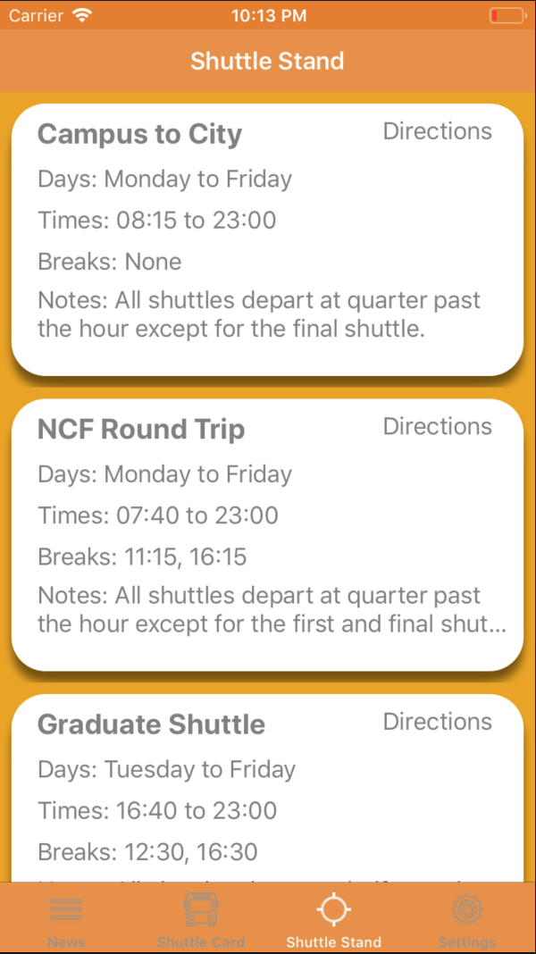
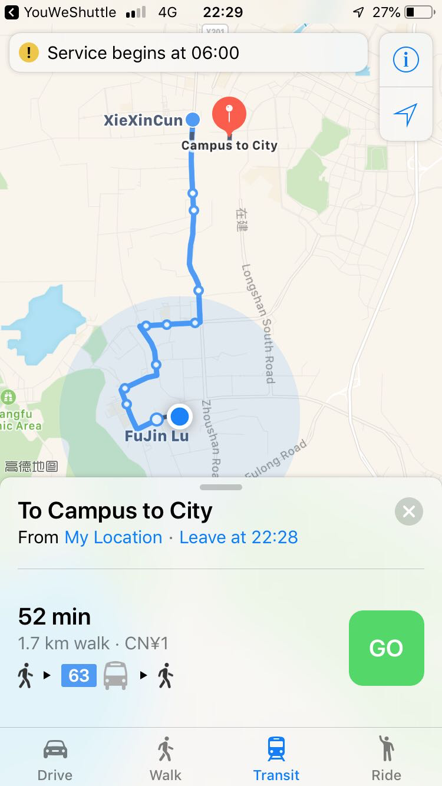
Shuttle Stand
03
Shuttle Schedule
Notes
Maps ( Amaps, Google Maps, Baidu )

Slide 11
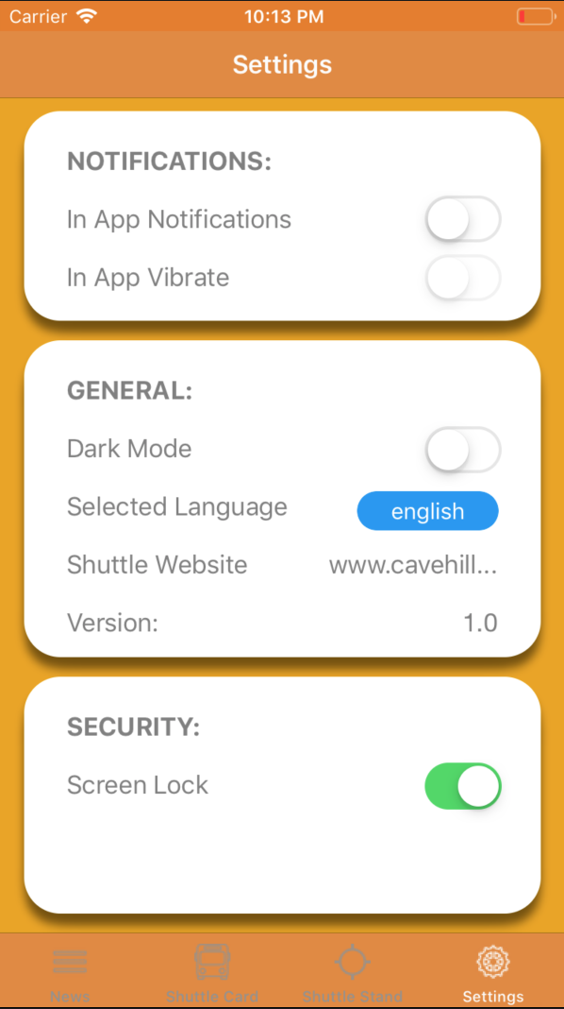
Settings
04
In App notifications
Dark Mode
Language Options
Screen Lock
Biometrics

Slide 12
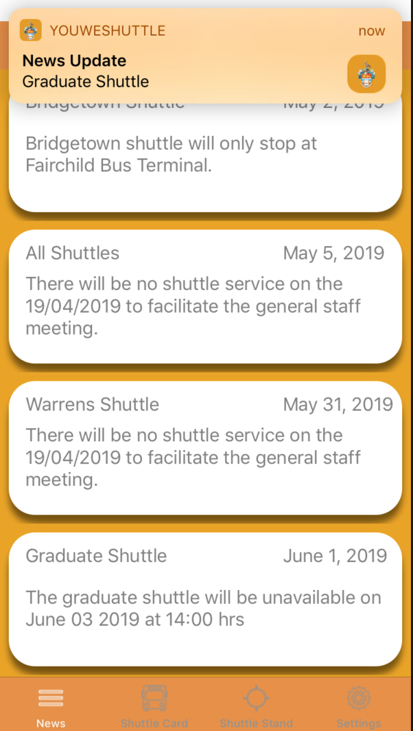
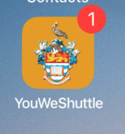
Push & Local Notifications
05
One Signal & Firebase Cloud Messaging
Custom Notification Icon
Notifications in Foreground

Slide 13
Android & iOS: A Comparison

Slide 14
Android & iOS: A Comparison

Slide 15
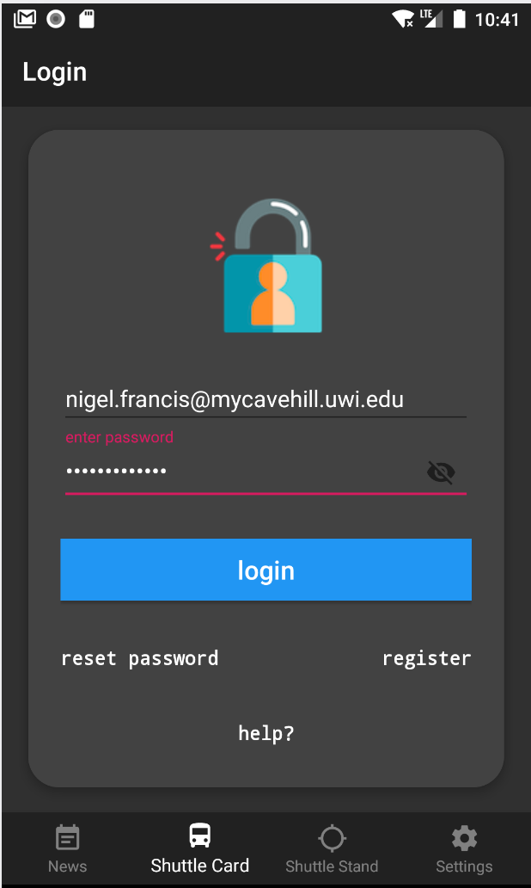
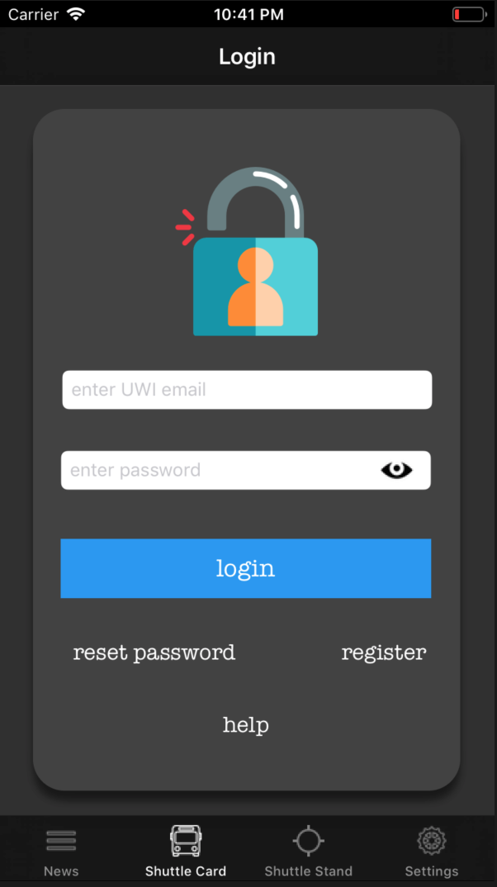
Android & iOS: A Comparison

Slide 16
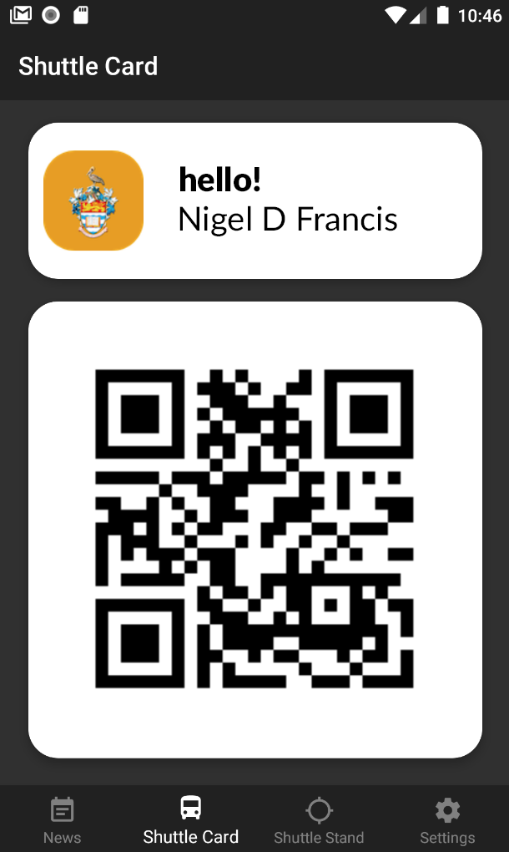
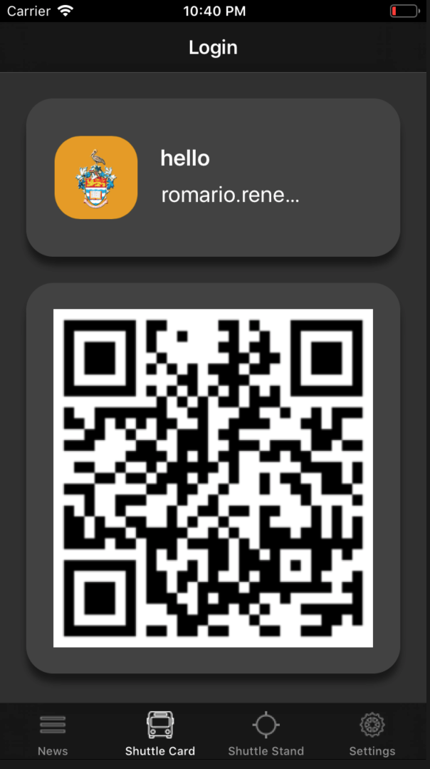
Android & iOS: A Comparison

Slide 17
Application Demonstration
How the NIRO Student Application works for iOS.

Slide 18
Next Steps

Slide 19
What next?
More Themes & Notification Tones
iOS Development
Website Version for News & Shuttle Stand with Social Media Integration
Maps for Routes
NCF Cards Acceptance
Facial Recognition
Recording a Journey ( Camera )

Slide 20
Questions?

